Slide 1

Predicting Customer Booking Behavior with Machine Learning
• Modeled 50,000+ booking records using Random Forest
• Identified key predictors of completed bookings
• Evaluated model performance (AUC = 0.79)
• Tools: Python, Pandas, Scikit-learn, Seaborn

Slide 2
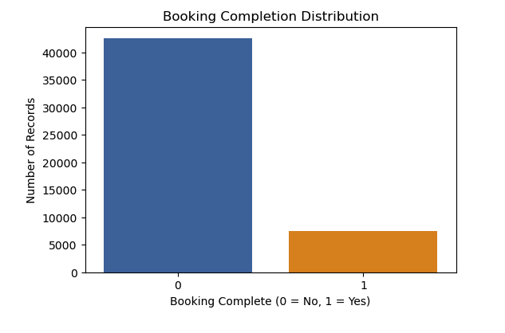
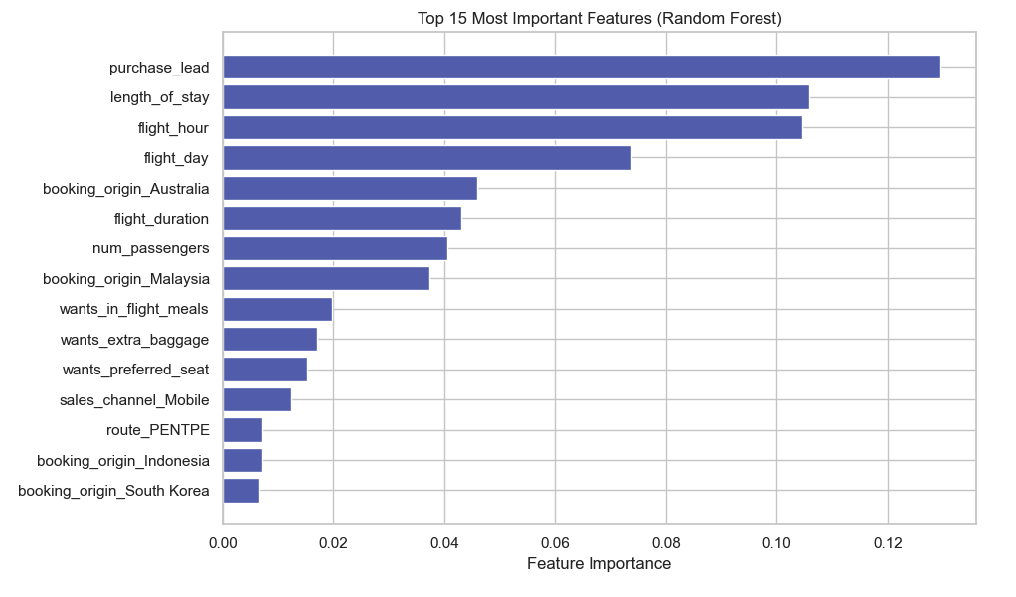
Predicting Customer Booking Behavior: Insights from 50,000+ Records
• Trained Random Forest on 50,000 booking records
• ROC AUC Score: 0.79 | Accuracy: 85%
• Class imbalance addressed using weighted classifier
• Top predictors: purchase lead, length of stay, flight hour

